Slide 1
Advanced Machine Learning Final Project On Hand Detection and Face Recognition Software
Submitted by: Aarush Bhardwaj
Kent ID: 811126136

Slide 2
Machine Learning Definition
ML is a branch of artificial intelligence:
Uses computing based systems to make sense out of data
Extracting patterns, fitting data to functions, classifying data, etc.
ML systems can learn and improve
With historical data, time and experience
Bridges theoretical computer science and real noise data.

Slide 3
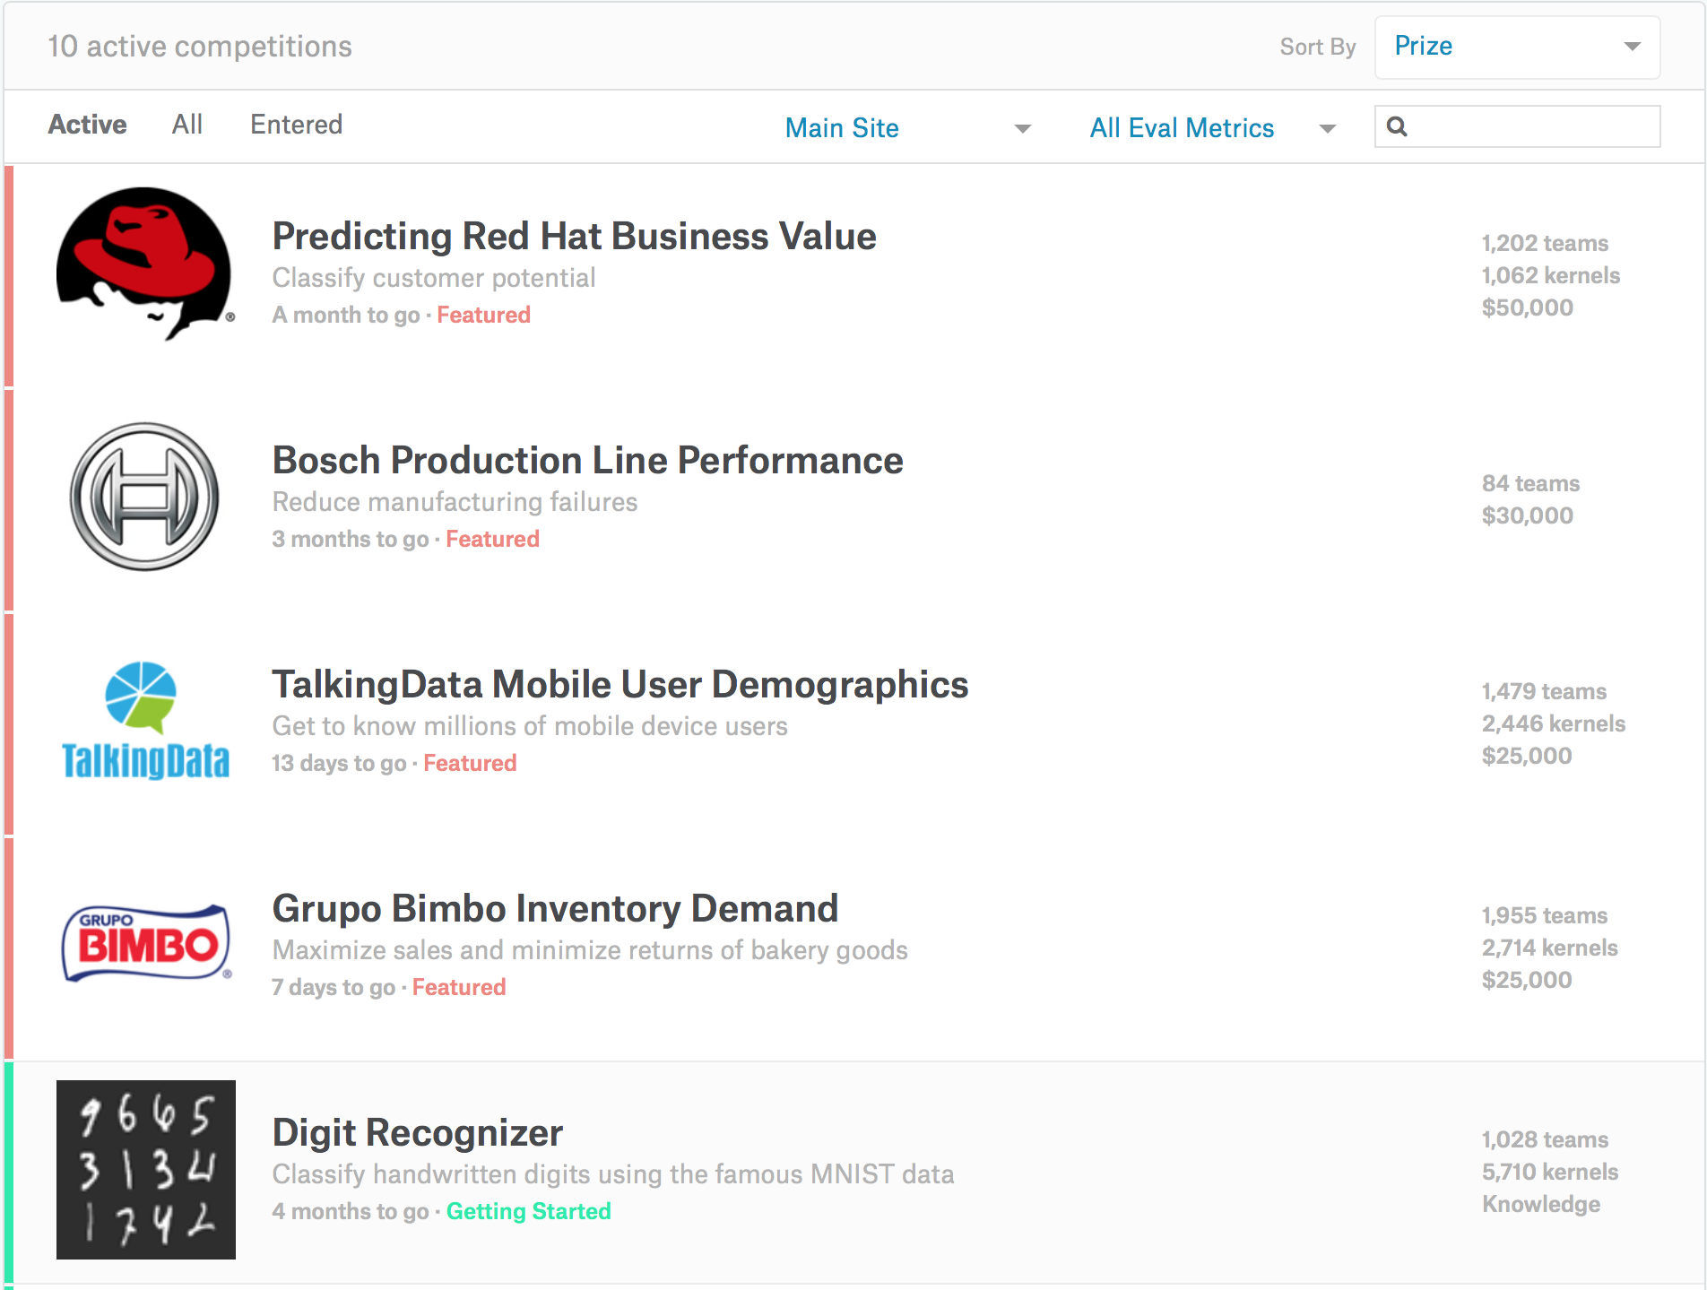

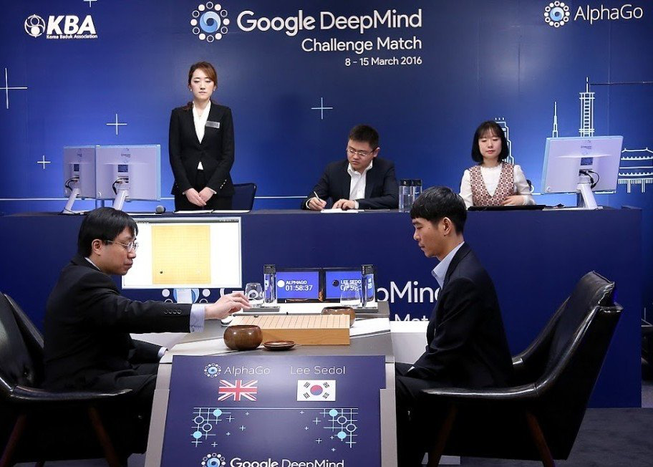
Machine Learning in Real World

Slide 4
Machine Learning as a Process
Define Objectives
Data Preparation
Model Building
Model Deployment
Model Evaluation
- Define measurable and quantifiable goals
- Use this stage to learn about the problem
- Normalization
- Transformation
- Missing Values
- Outliers
Study models accuracy
- Work better than the naïve
approach or previous system
Do the results make sense in the context of the problem
- Data Splitting
Features Engineering
Estimating Performance
Evaluation and Model Selection

Slide 5
Machine Learning as a Process: Data Preparation:
Needed for several reasons:
-Some Models have strict data requirements
-Scale of the data, data point intervals, etc
-Some characteristics of the data may impact dramatically on the model performance
-Time on data preparation should not be underestimated
Raw Data
Data Transformation
Data Ready
Scaling
Centering
Skewness
Outliers
Missing Values
Errors
Missing Values
Dimensionality
Types Problems
Error Values
Different Scales
Many others
Modeling phase

Slide 6
Machine Learning as a Process: Feature Engineering:
Determine the predictors (features) to be used is one of the most critical questions
Some times we need to add predictors
Reduce Number:
-Fewer predictors more interpretable model and less costly
-Most of the models are affected by high dimensionality, specially for non-informative predictors
-
-Binning predictors
Based normally on correlations
Evaluate the relevance of the predictor
Filters
Genetics Algorithms
Algorithms that use models as input and performance as output
Multiple models adding and removing parameter
Wrappers

Slide 7
Machine Learning as a Process: Model Building:
Data Splitting
Allocate data to different tasks
model training
performance evaluation
Define Training, Validation and Test sets
Feature Selection (Review the decision made previously)
Estimating Performance
Visualization of results – discovery interesting areas of the problem space
Statistics and performance measures
Evaluation and Model selection
The ‘no free lunch’ theorem no a priory assumptions can be made
Avoid use of favorite models if NEEDED

Slide 8
Project Overview:
The purpose of this project is to design a machine learning software that is able to translate hand gestures into a non-tangible input source for the computers.
This project will be an addition to the computer vision suit, which already comprises of Face Detection, Face Mesh, Iris Detection, Hair Segmentation and several others.
By the end of this project, the user will be able to control his computer audio just by using his hands.

Slide 9
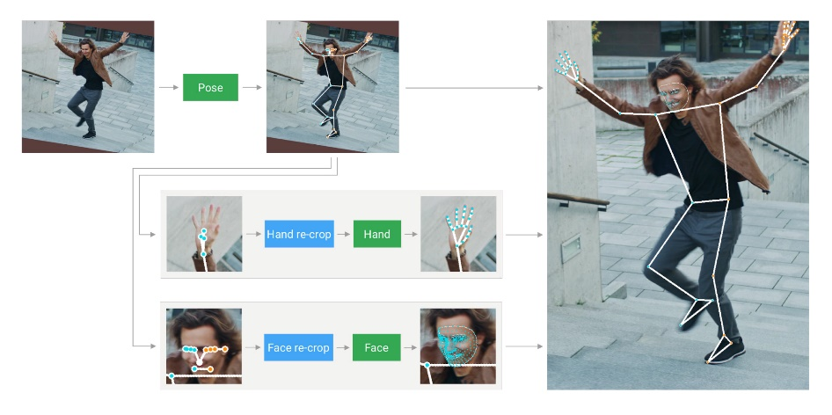
Model Selection: For Hand Detection
Approach 1: Using Convolutional Neural Network
Initial approach was to train a CNN model on a set of 1000K labled images, that was generated by using data augmentation.
Unfortunately, the performance of the model was not satisfactory, i.e the model was not able to converge.
Approach 2: Using TFLite
To design this software we are going to use MediaPipe, which is a library developed by google that gives us capability to use pre-trained models for computer vision.
For this specific one, we are going to use a pre-trained model, that has already annotated images of 30K hands. This model has been trained in TFLite, which is a light weight version of Tensorflow.
The greatest benefit of training a model in TFLite is it’s consistent performance across all the platforms.

Slide 10
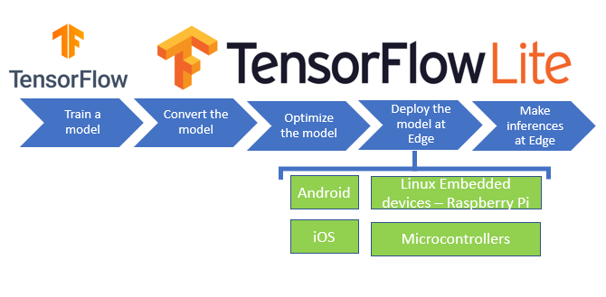
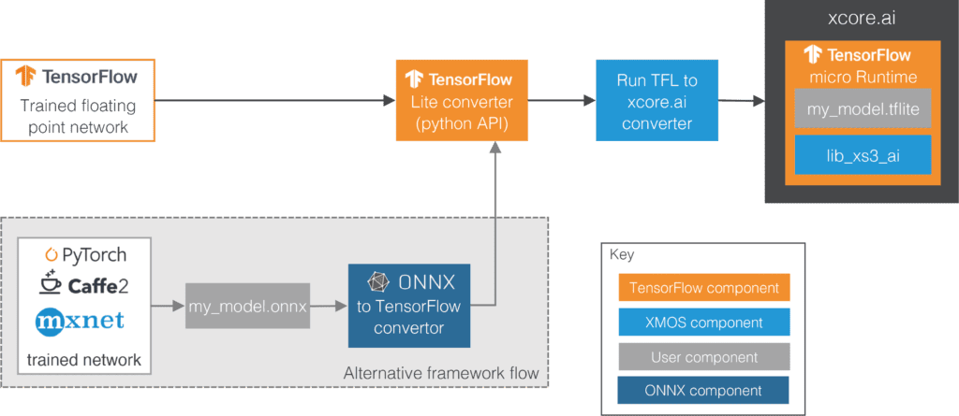
TFLite

Slide 11
Future Scope
In the future, I would like to integrate this project with the pose detection, Facial Recognition and Face Mesh (Currently under Development).
Play around with the model_complexity parameter in the Hands Module.

Slide 12
Referencs
https://www.tensorflow.org/lite
https://google.github.io/mediapipe/solutions/models.html#hands
https://mediapipe.dev/

Slide 13
Thank You

